Slide 1
L1 JURY PRESENTATION
AI Frontier Challenge 2026 · Offline Hackathon L1
Team Name
Team Leader
Tech Titans (TEAM-001450)
Varun Raj Chevala
Track
Date
Retail (R3): Shopping Assistant
Oct 30, 2026
Notes:
Introduce the team and the problem: R3, a shopping assistant that never invents prices. Round 1 was the proposal; today we show the working system on the real catalogue.

Slide 2
Use Case
Problem Statement
Shopping chatbots often invent products, prices and return rules that are not in the catalogue, and shoppers act on them.
Affected: online shoppers, and retailers who must honour what their bot says.
Impact: in Moffatt v. Air Canada (2024), a tribunal made the airline pay for a refund rule its chatbot got wrong.
Market Opportunity
India’s online retail is expected to grow from US$75 billion in 2024 to US$260 billion by 2030 (Deloitte and FICCI, 2025).
Target users: India’s online shoppers, expected to reach 400 million by 2030 (Redseer).
Smaller retailers need a low-cost assistant that states only catalogue facts.
Notes:
Why this matters: a chatbot that invents a price or a return rule creates a legal and trust problem. Moffatt v. Air Canada shows companies are held to what their bot says.

Slide 3
Solution Built
Solution Overview
What: a working chatbot over the 5,000-product catalogue and store policy that cites a product ID or policy section for every fact.
How: code reads the question, filters the catalogue and decides: answer, ask which one, or say “I don’t have that”.
LLM only as a fallback: when the rules can’t understand a message (“bread garam karne wali machine”), Groq rewrites it and the rules decide again.
Safe: every price comes from the catalogue, and a final guard removes any ₹ amount that isn’t backed by a cited product.
Shopper question in English or Hinglish
Parse names, filters and budget
Decide: answer, clarify or refuse
LLM rewrite only if not understood
Reply with catalogue facts and citations
Notes:
Walk through the flow left to right. Stress that code makes every decision and copies every fact; the LLM only rewrites messages the rules could not read.

Slide 4
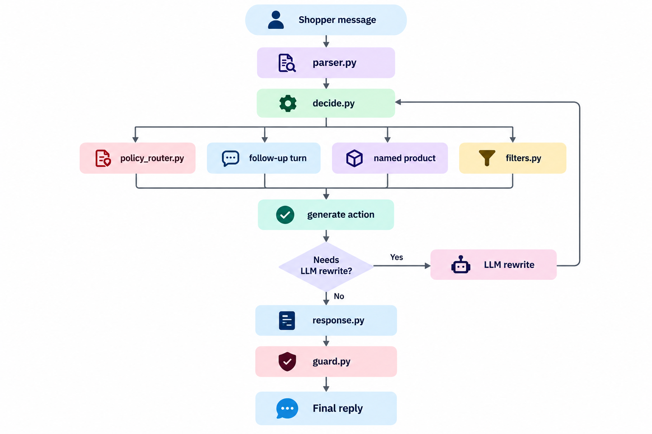
Design Steps & Architecture
Technical Implementation
Architecture Diagram
1. Understand: parser built from the catalogue’s own brands, product lines, colours and units; fuzzy matching fixes “krida ion flex”.
2. Decide: filters, policy router and conversation memory choose answer, clarify or refuse, all in code.
3. Fallback: Groq gpt-oss-20b rewrites messages the rules can’t read; the output is validated and the rules decide again.
4. Reply and check: facts are copied from the catalogue, and the guard re-checks every ₹ amount with the scorer’s rules.
Notes:
Explain the four steps, then point at the diagram: parser, decide with its four branches, the LLM rewrite loop back into decide, then response and guard.

Slide 5
Tools & Technologies
Tech Stack
Python 3.11 + uv
language, locked dependencies
FastAPI + Pydantic
API and validation
rapidfuzz
fuzzy name matching
HTML / CSS / JS
chat UI with Sources panel
Groq API
gpt-oss-20b LLM fallback
pytest
71 automated tests
Code quality checks
lint and security scans
evaluate.py
organisers’ official scorer
Engineering Practices
Core logic separate from the web layer; all settings in config.yaml; secrets only in .env.
Structured logging, timeouts on every network call, input validation and rate limiting on the API.
Notes:
Mention that the stack is light: no GPU, no vector database, runs on a laptop. The project follows the hackathon coding guidelines.

Slide 6
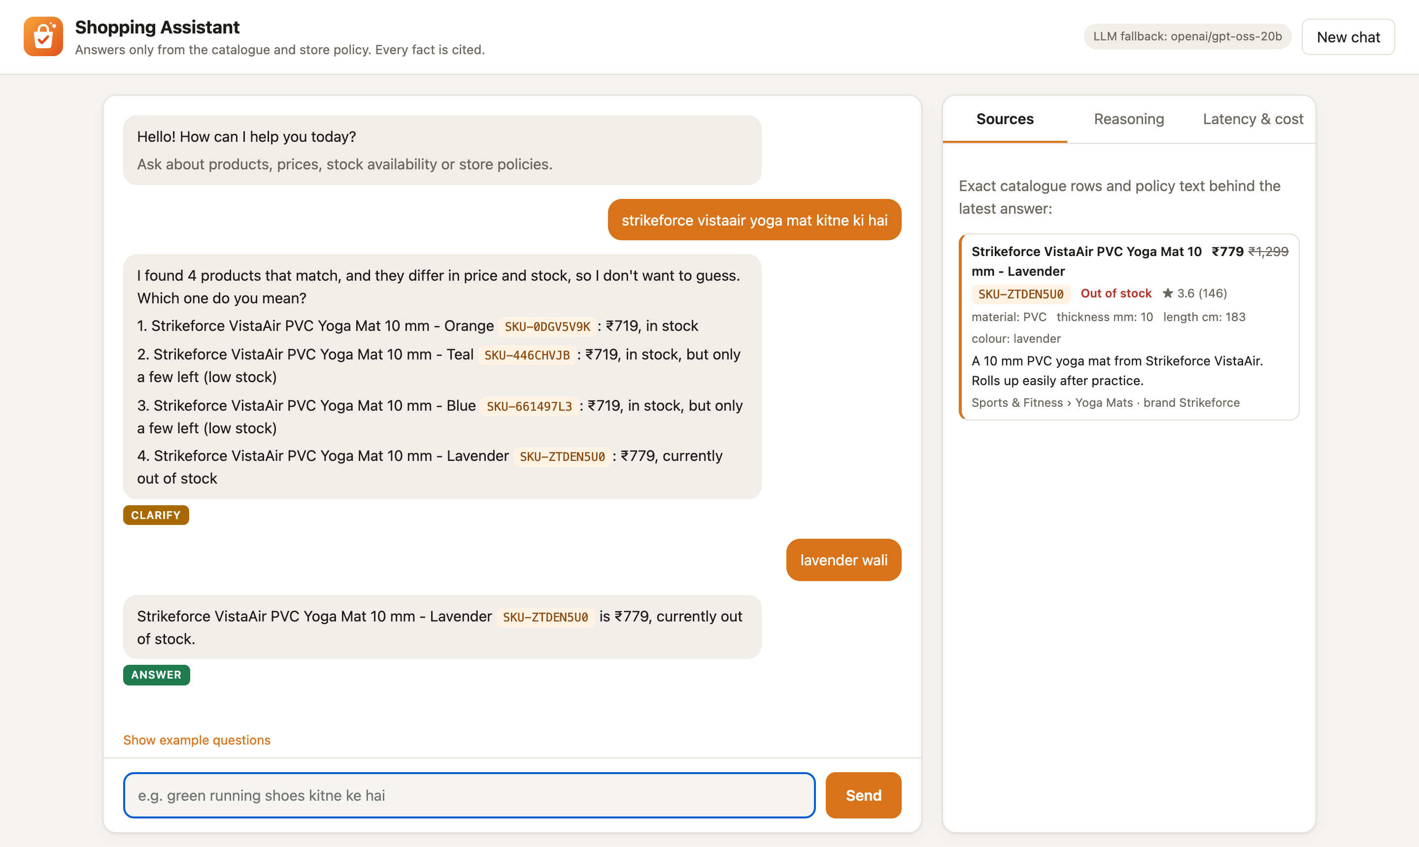
Demo
Live Demonstration
Try These Questions
ANSWER · English
Price of Chargit QuillBolt red earphones?
CLARIFY · Hinglish
green running shoes kitne ke hai
POLICY · English
Can I return earbuds after opening the seal?
REFUSE · Hinglish
iphone 15 milega?
MULTI-TURN · Hinglish
6 mm yoga mat chahiye → TPE wali 600 ke andar
LLM · English
How much is a machine that toasts bread?
Chatbot: http://127.0.0.1:8000 API docs: http://127.0.0.1:8000/api/docs
Notes:
Live demo at http://127.0.0.1:8000. Suggested order: price, clarify, follow-up 'lavender wali', a policy question, a refusal, then the LLM fallback question.

Slide 7
Unique Selling Proposition (USP)
Key Differentiator 1
Key Differentiator 2
Key Differentiator 3
Prices cannot be invented
Code copies every price from the catalogue and the guard re-checks every ₹ amount: 0 hallucinated prices.
Rules first, LLM only when needed
~1 ms and $0 per query. The LLM only rewrites unclear messages and never states a fact.
Built for Indian shoppers
Understands Hinglish, misspellings and descriptions like “baal sukhane wala machine”, and remembers budget and filters across turns.
Competitive Advantage Summary
Why choose us: shoppers get answers they can check, with a product ID or policy section next to every fact, and retailers never promise what they don’t sell.
Versus alternatives: general chatbots answer confidently even when wrong; ours is fast, nearly free, and honest by design.
Notes:
Three differentiators, then the one-line comparison with general-purpose chatbots.

Slide 8
Results & Evaluation
1.000
0
~1 ms
Dev score (baseline 0.73)
Hallucinated prices
Per query, $0 cost
Official evaluate.py on 40 dev questions: action, grounding and helpfulness all perfect.
Every ₹ amount is copied from the catalogue and re-checked by the price guard.
Rules answer offline with 0 tokens. The LLM fallback uses ~900 tokens, ~0.5 s, ~$0.0001.
Test Set and Quality Checks
150 test questions answered: 82 answer, 30 clarify, 38 refuse, close to the expected test mix.
71 automated tests pass; ruff lint clean; pip-audit finds no known vulnerabilities.
Every example in our questions guide was verified against the live assistant.
Notes:
All numbers come from the organisers' evaluate.py and our latency report. Dev is 40 questions; the 150 test answers are scored by the organisers.

Slide 9
Responsible AI
How Every Answer Stays Grounded
Every fact carries a product ID or policy section, and the Sources panel shows the exact catalogue row.
Missing ≠ false: if the catalogue doesn’t list a feature, the assistant says so instead of guessing.
It asks which product is meant when several match, and refuses unsold items, other brands and policy gaps.
Safe Use of the LLM
Fallback only, and it never writes prices, stock or IDs; its output is validated and invented brands are dropped.
Shopper text is treated as data (prompt-injection safe); the API key lives in .env, never in code.
Timeouts, retries and rate-limit handling; if Groq is down, the rules keep answering offline.
Notes:
Responsibility is 15% of the rubric. Emphasise: no invented facts, honest refusals, and the LLM has no way to put a price or product ID in front of a shopper.

Slide 10
Challenges & Mitigation
Challenge 1: Hinglish and confusing names
Problem: Misspelt or split names (“krida ion flex”); Hindi words that are also product names (“khilona”).
Mitigation: Catalogue-built vocabulary, fuzzy matching, and ignoring coincidental names.
Challenge 2: Ambiguous questions and missing facts
Problem: Many variants differ in price or stock, and many attributes are simply not listed.
Mitigation: Clarify only when the asked detail differs; treat missing facts as unknown and refuse instead of guessing.
Challenge 3: An unpredictable, rate-limited LLM
Problem: Wrong mappings (clothes dryer → hair dryer), invented brands, and HTTP 429 rate limits.
Mitigation: Translate-then-map prompt, validation, one retry and back-off; the rules keep answering.
Notes:
These are real problems we hit while testing on the actual catalogue, not hypothetical ones.

Slide 11
Limitations & Next Steps
Known Limitations
The Hinglish word list is hand-written; very unusual phrasing can still be refused.
The LLM fallback needs network access, adds ~0.5 s, and can occasionally pick the wrong product type.
Conversation memory and rate limiting are in-memory: demo scale, no user accounts.
Next Steps
Learn new Hinglish words and product aliases from real shopper logs.
Add a feedback button so wrong answers are flagged and reviewed.
Move memory to a shared store and add authentication for production use.
Notes:
Be honest about limits; the jury rewards it. Then show the path to production.

Slide 12
THANK YOU
Questions?
Tech Titans · Retail (R3) · Shopping Assistant that doesn’t lie
Notes:
Thank the jury and invite questions. Have the live demo open in a browser tab.

